Slide 1
Psychology of Affect and Relationships
The Biology of Emotions: What drives motivation?
Why it is important for us to care and how our professional relationships can make a difference
Scott I-Patrick
Educational Psychologist

Slide 2
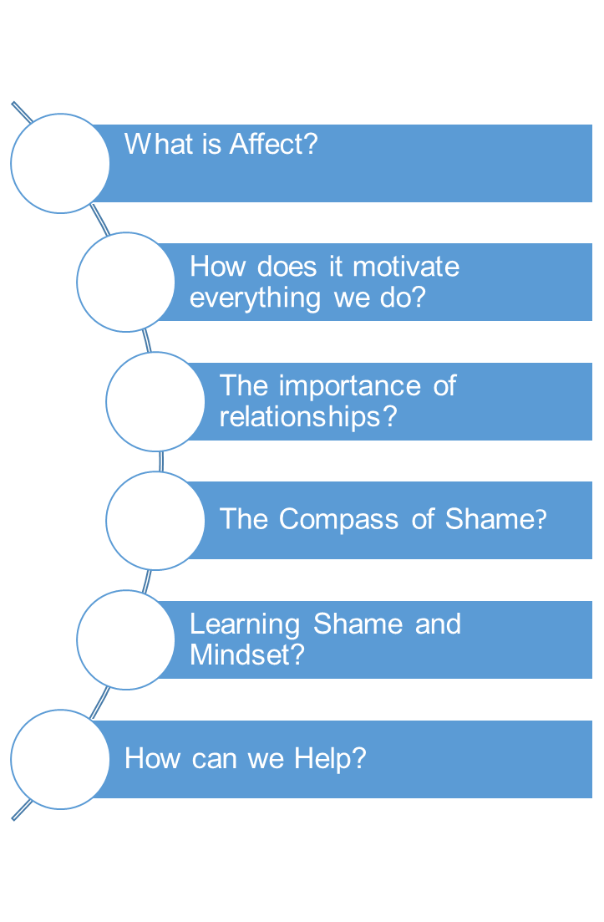
Outline

Slide 3
What is Affect?
A biological programme hard wired into our central nervous system from birth. It is a brief biological response to stimulus conditions - with an evolved function of directing our attention to what is important for us to care about/focus our attention on.

Slide 4
The Affect System in the Brain Consists of Nine Affects (Tomkins (1962)
Positive Affects
Interests - Excitement
Enjoyment-Joy
Neutral Affects
Surprise - Startle
Negative Affects
Distress - Anguish
Fear – Terror
Anger – Rage
Shame – Humiliation
Disgust
Dismell

Slide 5
Motivation and the Cognitive System
Affect motivates everything we think or do. We are all wired from birth to experience positive and negative affect based on stimulus conditions around us. We care - are motivated to automatically seek more positive feelings and to stop negative feelings.
The affect system works in conjunction with many other brain systems - Cognitive systems)
Memory - ability to analyse and compare experiences
Scene – Stimulus – Affect - Response
Scripts
Feelings
Emotions

Slide 6
The Central Blueprint
Maximise positive affect
Minimise negative affect
Minimise the inhibition of affect
Maximise the power to maximise positive affect , minimise negative affect, and minimise the inhibition of affect.

Slide 7
The Importance of Relationships
What is the evolved function of affects?
Focus on the ‘Affect’ – ‘Shame’

Slide 8
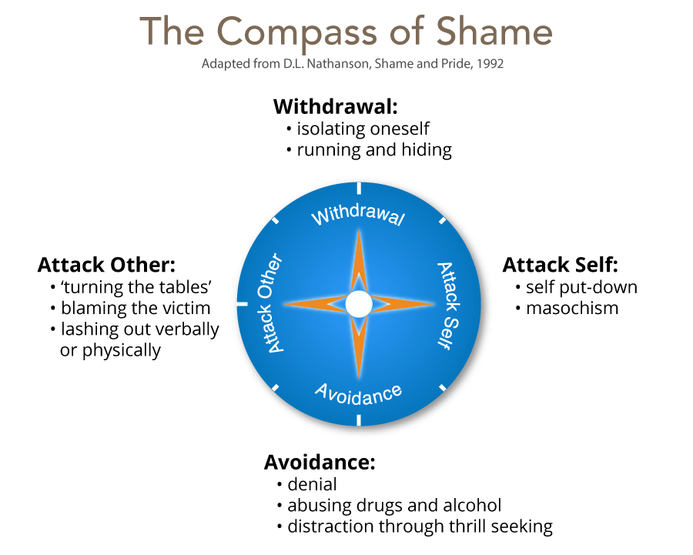
How Do We Resolve Uncomfortable Feelings

Slide 9
What Does it All Mean?
Affects trigger themselves, so that what is triggered in me triggers the same in someone that I am dealing with – which is why emotion is contagious.
Knowing this and thinking of children who we work with who we feel have impediment to their excitement and joy
How can we help them maximise positive affect and minimise negative affects through our relationship with them directly and/or with their wider social systems?

Slide 10
Learning Shame
Withdraw - Switch off from learning and not attend lessons.
Attack self - Put themselves down, assume they are dumb.
Avoid - Be the class clown, focus on other aspect of their lives, take risks, use drugs etc.
Attack other - Put others down, belittle value of work, diminish someone, bully others.

Slide 11
Cognitions, Affects, & Behaviours Associated with Mindset
Pupils have certain self-theories about their ability and have a set of scripts around learning.
Mindset – Shame Affect is central to complex learning.

Slide 12
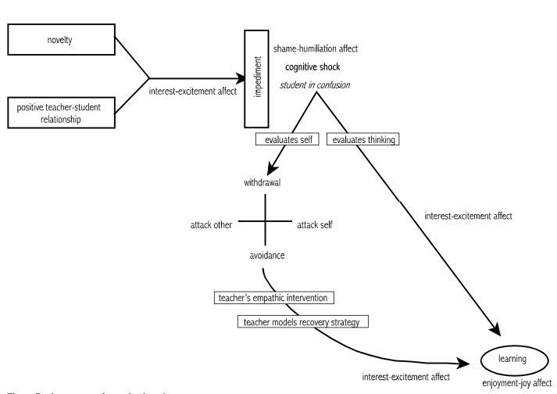
The process of complex learning (George, 2014, p.224)

Slide 13
Fixed Mindset
Pupils believe that their capabilities are fixed since they are part of the self and the self is fixed and constant.
Stimulus = Challenge = self-doubt, helplessness
Affect = distress, fear, anger, shame
Behaviour = risk avoidance, defensiveness, competitiveness, withdrawal hostility, lying.

Slide 14
Growth Mindset
Pupils believe that capabilities can be developed through effort, i.e., through behaviour.
Stimulus = Challenge = self-confidence, aspiration
Affect = interest-excitement, enjoyment joy
Behaviour = high effort, challenge-seeking, cooperativeness, persistence

Slide 15
Questions to consider about the Mindset of the pupils you support?
What is their desire/ motivation for learning?
How do they evaluate situations?
How do they deal with setbacks?
How do they deal with setbacks?
How do they perceive danger?
How do they perceive effort?
How do they respond to criticism?
How do they perceive others success?

Slide 16
How Can We Help?
Empathic intervention – cant happen without trust and mutual respect (unconditional positive regard)
Promote a growth mindset
Establish high expectations (not just high standards).
Create a risk-tolerant learning zone
Give feedback that focuses on process – things that he can control
Focus on how tasks/activities are framed and how feedback is provided

Slide 17
Framing tasks
Example of communicating learning goals: we are in the learning zone today; mistakes are our friends!
Communicating high expectations
Example of communicating high expectations: As you learn this, mistakes are expected. Your mistakes help me to support you. Let’s make mistakes together!
Giving feedback:
example of when he struggles despite strong effort: I admire your persistence and I appreciate your hard work. It will pay off!
Example of when he struggles and needs help with strategies: Let’s do one together…
Example of when he is making progress: I see you using your strategies/tools/notes etc. keep it up!
Example of when he succeeds with strong effort: I am very proud of you for not giving up and look what you have to show for it!

Slide 18
It is all about relationship quality and our willingness to engage.
Thank You
Please do not use or copy any slides without prior permission from Buckinghamshire EPS

Slide 19
References
George, G. (2014). Affect and Emotion in a Restorative School. In V. Kelly & M. Thorsborne (Eds.), The Psychology of Emotions in Restorative Practice (First, pp. 200–231). Jessica Kingsley.
Dweck, CS, 2012, Mindset, Constable & Robinson, London, 2012
Kelly, V. C. (2014). Caring, Restorative Practice and the Biology of Emotion. In V. Kelly & M. Thorsborne (Eds.), The Psychology of Emotions in Restorative Practice (First, pp. 200–231). Jessica Kingsley.
Nathanson, D.l. (1992) Shame and Pide: Affect, Sex, and the Birth of the self. New York, NY: W.W. Norton.
Tomkins. S. (2008) Affect Imagery Consciousness: the Complete Edition. New york, NY : Springer.

